Slide 1
Hotel investment in the neighborhoods of Athens
THODORIS MAKRIDAKIS
IBM APPLIED DATA SCIENCE CAPSTONE

Slide 2
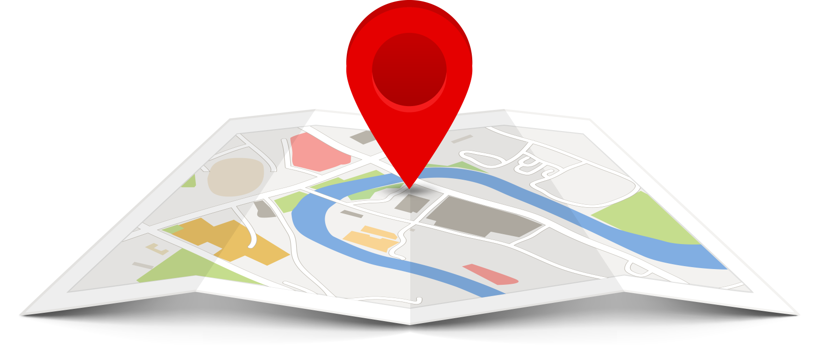

Business Problem
Location
An international fund plans to expand its hotel amenities in Athens, Greece with a 4* or 5* star hotel
After the successful treatment of COVID-19, the fund believes that Athens is not only a safe choice for tourism but also the country is highly ranked among the tourist destinations worldwide
Objective:
The project will analyze all possible locations in Athens in order to acquire the possible best ones in Athens for the new hotel

Slide 3


Data
Data
A list of neighborhoods of Athens
Latitude and longitude of the neighborhoods
Venue data, particularly data related with the category of hotels
Sources of data
Wikipedia page for neighborhoods
(https://en.wikipedia.org/wiki/Category:Neighbourhoods_in_Athens)
Geocoder package for latitude and longitude coordinates
An account to Foursquare API for venue data

Slide 4

Methodology
Web scraping from Wikipedia page for the neighborhood list (BeautifulSoup)
Getting latitude and longitude for the neighborhoods (Geocoder)
Connect to Foursquare API to get the venue data
Group data by neighborhood and then compute the frequency of the 5 most common amenities in each neighborhood
Use filter to get the frequency only for hotels in each neighborhood
Perform clustering of neighborhoods using k-means
Visualize the clusters in a map using Folium

Slide 5
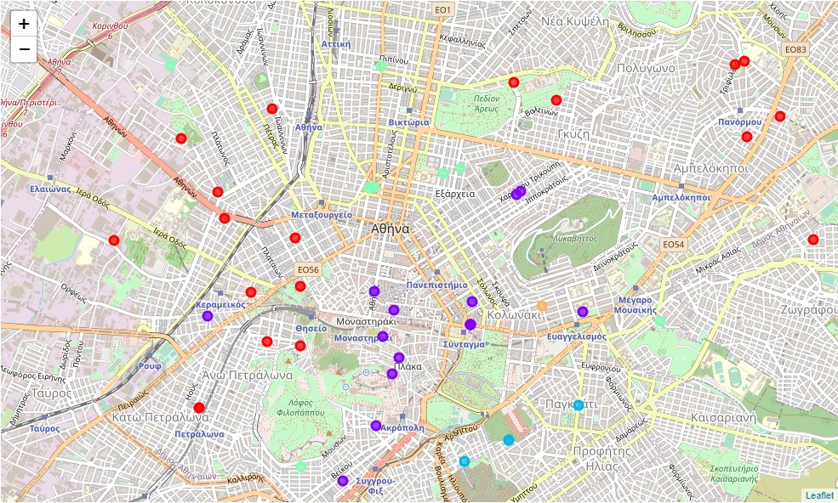
Results
k-means clustering categorized the neighborhoods in 5 clusters
Cluster 0
Cluster 1
Cluster 2
Cluster 3
Cluster 4

Slide 6
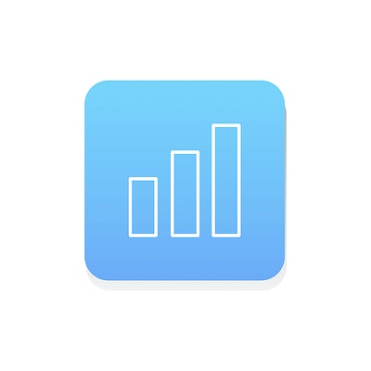
Discussion
Cluster 0
Size : 31 neighborhoods
Frequency of Hotels : Very Low
Density: Moving outside the center
Cluster 1
Size : 14 neighborhoods
Frequency of Hotels : Moderate
Density: In the center of city
Cluster 2
Size : 3 neighborhoods
Frequency of Hotels : Very High
Density: Very close to the center of city
Cluster 3
Size : 10 neighborhoods
Frequency of Hotels : Low
Density: Close to the center
Cluster 4
Size : 1 neighborhood
Frequency of Hotels : High
Density: In the center of city

Slide 7

Conclusion
A suggestion based on this project will be in the Cluster 0 in the neighborhoods very close to the center of Athens. The reasons in order to operate a new hotel there are 3:
The competiveness is very low in these neighborhoods with great prospects of profit
In a very close distance, there are ancient monuments and museums but also the center of Athens
There is a dense public transport network connecting all main destinations not only in Athens but in other districts

Slide 8
Thank you!!!

